Slide 1
ITEC 102 INTRODUCTION TO INFORMATION SYSTEMS
DANIEL OBUOBI, DCSIT, CU
ORGANISATION MANAGEMENT & IS, TYPES OF INFORMATION SYSTEMS

Slide 2
Organizations, Management and Information

Slide 3
A Business Perspective on Information Systems
Managers and business firms invest in information technology and systems because they provide real economic value to the business.
There are also situations in which firms invest in information systems to cope with governmental regulations or other environmental demands.
It is assumed that most information systems investments will be justified by favourable returns.

Slide 4
A Business Perspective on Information Systems
Every business has an information value chain, in which raw information is systematically acquired and then transformed through various stages that add value to that information.
Although there are other reasons why systems are built, their primary purpose is to contribute to corporate value.

Slide 5
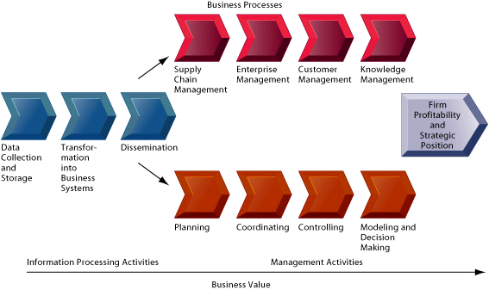
The business information value chain

Slide 6
A Business Perspective on Information Systems
An information system represents an organizational and management solution, based on information technology, to a challenge posed by the environment.
Using information systems effectively requires an understanding of the organization, management, and information technology shaping the systems.

Slide 7
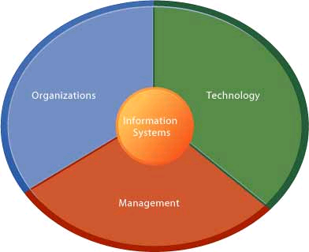
Information systems are more than computers
An information system creates value for the firm as an organizational and management solution to challenges posed by the environment.

Slide 8
Dimensions of Information Systems
Information systems are an integral part of organizations.
The key elements of an organization are its people, structure, business processes, politics, and culture.
Organizations are composed of different levels and specialties. Experts are employed and trained for different functions.

Slide 9
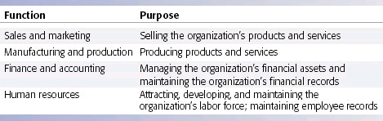
Major Business Functions

Slide 10
Organization
An organization coordinates work through a structured hierarchy and through its business processes.
The hierarchy arranges people in a pyramid structure of rising authority and responsibility.
Many business processes are incorporated into information systems, such as how to pay a supplier or how to correct an erroneous bill.
Organizations require many different kinds of skills and people.

Slide 11
Organization
Each organization has a unique culture, or fundamental set of assumptions, values, and ways of doing things, that has been accepted by most of its members.
Different levels and specialties in an organization create different interests and points of view.
Information systems come out of this cauldron of differing perspectives, conflicts, compromises, and agreements that are a natural part of all organizations.

Slide 12
Dimensions of Information Systems
Management’s job is to
  make sense out of the many situations faced by organizations,
  make decisions,
  and formulate action plans to solve organizational problems.
Managers perceive business challenges in the environment.

Slide 13
Management
They set the organizational strategy for responding to those challenges;
They allocate the human and financial resources to coordinate the work and achieve success.
A substantial part of management responsibility is creative work driven by new knowledge and information.
Information technology can play a powerful role in redirecting and redesigning the organization.

Slide 14
Management
Managerial roles and decisions vary at different levels of the organization.
Senior managers make long-range strategic decisions about what products and services to produce.
Middle managers carry out the programs and plans of senior management.
Operational managers are responsible for monitoring the firm’s daily activities.

Slide 15
Dimensions of Information Systems
Technology
  Information technology is one of many tools managers use to cope with change.
  The world’s largest and most widely used network is the Internet.
  The Internet connects hundreds of thousands of different networks from more than 200 countries around the world.

Slide 16
Technology
The Internet has created a new “universal” technology platform on which to build all sorts of new products, services, strategies, and business models.
Firms uses the internet to coordinate their activities with other firms for making purchases, collaborating on design, and other inter-organizational work.

Slide 17
Technology
Because the internet offers so many new possibilities for doing business, the Internet service known as the World Wide Web is of special interest to organizations and managers.
The IT infrastructure provides the foundation, or platform, on which the firm can build its specific information systems.
Each organization must carefully design and manage its information technology infrastructure.

Slide 18
Information and Management
The manager should be able to define the type of information he/she requires and the Management Information System (MIS) should be able to supply it.
It does not happen like this and managers have to use whatever information is available, from whatever source.
But managers need relevant information to assist them to plan, to control, and to make decisions.

Slide 19
Information and Management
Relevant information is information which:
  Increase knowledge.
  Reduce uncertainty.
  Is usable for the intended purpose.
Although managers need information they do not all need the same type of information.
The type of information required is dependent on many factors including;
  the level of management,
  the task at hand,
  confidentiality,
  urgency etc.

Slide 20
Information Classification
Information may be classified in many ways including:
  By source - e.g. internal, external, primary, secondary, Government etc
  By nature - e.g. qualitative, quantitative, formal, informal etc.
  By level - e.g. strategic, tactical, operational etc.
  By time - e.g. historical, present, future
  By frequency - e.g. continuous (real time), hourly, daily, monthly, annually

Slide 21
Information Classification
By use - e.g. planning, control, decision making etc.
By form - e.g. written, aural, visual, sensory etc
By occurrence - e.g. at planned intervals, occasional, on demand etc.
By type - e.g. detailed, summarised, aggregated, abstracted etc.

Slide 22
Data and Information Defined
The term ‘data’ and ‘information’ are used interchangeably in everyday speech as meaning the same thing.
Data are facts, events, transactions and so on which have been recorded. They are the input raw materials from which information is produced.
Information is data that have been processed in such a way as to be useful to the recipient.

Slide 23
Data Characteristics
Data are facts obtained by reading, observation, counting, measuring, and weighing etc which are then recorded.
Data are derived from both external and internal sources.
Most external data are in readily usable and concrete form – for example, bank statements, purchase invoices etc.
Internal activities require appropriate measuring and recording systems so that facts can be captured.

Slide 24
What is information?
Information is data that have been interpreted and understood by the recipient of the message.
There is a process of thought understanding involved and it follows that a given message can have difference meanings to different people.
Information should be understood by the recipient.

Slide 25
What is information?
It reduces uncertainty and has surprise value.
  It must contain something which is not already known, which could not be predicted by the recipient.
If a message or report does not have these attributes, as far as the recipient is concerned, it contains merely data not information.

Slide 26
The Functions Performed by Information
The reduction of uncertainty
  uncertainty exists where there is less than perfect knowledge.
As an aid to monitoring and control
  by providing information about performance and extent of deviations from planned levels of performance, management are better able to control operation.
As a means of communication
  managers need to know about developments, plans, forecast, and impending changes and so on.

Slide 27
The Functions Performed by Information
As a memory supplement
  by having historical information about performance, transactions, results of past actions and decisions available for reference, personal memories are supplemented.
As an aid to simplification –
  by reducing uncertainty and enhancing understanding, problems and situations are simplified and become more manageable.

Slide 28
The Value of Information
Information has no value in itself;
  Its value derives from the value of the change in decision behaviour caused by the information being available minus the cost of producing the information.
Information should be able to improves the resulting decisions, otherwise it has no value.
The value of information may arise – providing that the information is used to improve decision making.

Slide 29
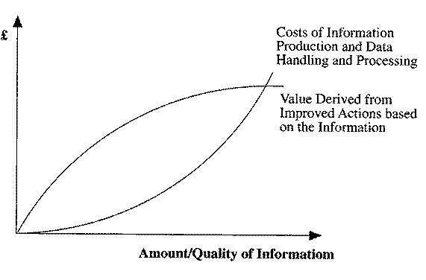
information – cost and value

Slide 30
Characteristics of Good Information
Good information is:
  relevant for it purpose.
  sufficiently accurate for its purpose.
  complete enough for the problem.
  from a source in which the user has confidence.
  communicated to the right person.
  communicated in time for its purpose.
  that which contains the right level of details.
  communicated by appropriate channel of communication.
  that which is understandable by the user.

Slide 31
Communication Methods
Various channels of communication are used by organizations.
Face-to-face Communication
Interview
Formal meeting
Informal contacts
Talks and discussion groups
Video telephones

Slide 32
Communication Methods
Written communication
  External mail by letter
  Internal mail by memoranda
  Booklets and manuals
  Reports
  Statements and tabulations
  Company, magazines, newsletters and bulletins.
  Fax.

Slide 33
Communication Methods
Visual communication
  Films and slides
  Videos
  Charts
  Posters
Oral communication
  Telephone
  Public address system

Slide 34
Communication Methods
Electronic communication
  Video displays using electronic mails (e-mail).
  Data transaction networks.
  Electronic data exchange (i.e. computer to computer)
  Telex
  pagers

Slide 35
Channels of communication
Information must be transmitted by means of a communication process.
Communication involves the interchange of facts, thoughts, value judgements and opinions and
the communication process may take many forms;

Slide 36
Forms of communication
The communication process may take the following forms;
  face-to-face conversations,
  telephone calls,
  informal meetings,
  conferences,
  memoranda,
  letters,
  reports,
  tabulations and so on.

Slide 37
Understandability
Understandability is what transforms data into information.
Many factors affect understandabilty including:
  Preference of the user
  Remembered knowledge
  Environmental factors
  Language

Slide 38
Factors that affects understandability
  Preference of the user – Some people prefer information in the form of pictures and graphs, others prefer narrative.
  Remembered knowledge - Understanding is thus a result of the association of memory and the received message.

Slide 39
Factors that affects understandability
Environmental factors
  a number of environmental factors influence understanding.
    These include; group pressures, the time available, trust in the information system and so on.
Language
  Information is conveyed by means of signals or messages.
    These may be in a code (e.g. mathematical notation) or in a natural language, such as English

Slide 40
Information Systems, Organizations, Management and Strategy
Laudon & Laudon
PowerPoint by Daniel Obuobi

Slide 41
Organizations and Information Systems
Organizations and information systems have a mutual influence on each other.
The information needs of an organization affect the design of information systems and an organization must be open itself to the influences of information systems in order to more fully benefit from new technologies.
The organization's environment, culture, structure, standard operating procedures, politics, and management decisions are mediating factors that influence the interaction between information technology and organizations. [Figure 3-1]

Slide 42
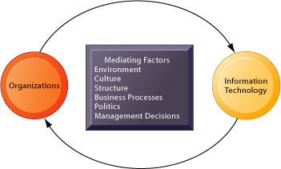
The two-way relationship between organizations and IT
FIGURE 3-1 The two-way relationship between organizations and information technology
This complex two-way relationship is mediated by many factors, not the least of which are the decisions made—or not made—by managers.
Other factors mediating the relationship include the organizational culture, structure, politics, business processes, and environment.

Slide 43
Technical & Behavioral Definitions
Technically defined, an organization is a formal, legal, social structure that processes resources to produce outputs. [Figure 3-2]
A behavioral definition of an organization is a collection of rights, privileges, obligations, and responsibilities that is balanced over time through conflict and conflict resolution. [Figure 3-3]

Slide 44
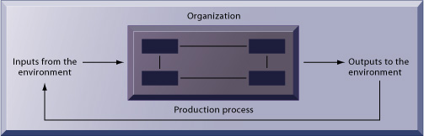
microeconomic definition
FIGURE 3-2 The technical microeconomic definition of the organization
In the microeconomic definition of organizations, capital and labor (the primary production factors provided by the environment) are transformed by the firm through the production process into products and services (outputs to the environment).
The products and services are consumed by the environment, which supplies additional capital and labor as inputs in the feedback loop.

Slide 45
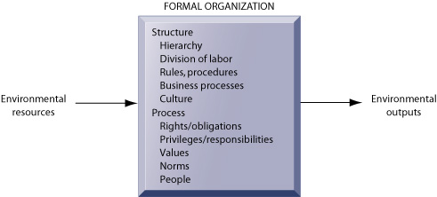
behavioral view
FIGURE 3-3 The behavioral view of organizations
The behavioral view of organizations emphasizes group relationships, values, and structures.

Slide 46
Technical & Behavioral views
Technological change requires changes in who owns and controls information, who has the right to access and update that information, and who makes decisions about whom, when, and how.
The technical and behavioral view of organizations complement one another.
The technical definition describes how thousands of firms in competitive markets combine capital and labor with information technology, whereas the behavioral model describes how technology affects the organization’s inner workings.

Slide 47
Organizations & bureaucracies
All modern organizations can be seen as bureaucracies that share some essential characteristics:
  clear division of labor,
  hierarchy,
  explicit rules and procedures,
  impartial judgments,
  technical qualifications for positions, and
  maximum organizational efficiency.
Additionally, all organizations develop routines and business procedures, politics, and cultures.
Business processes are collections of routines, or standard operating procedures (SOPs), which enable a firm’s efficiency. [Figure 3-4]

Slide 48
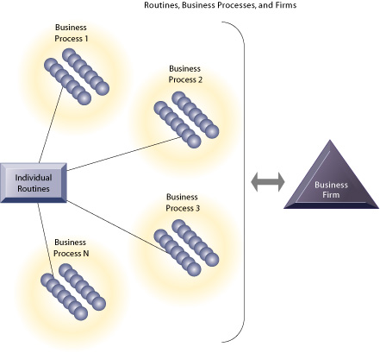
BUSINESS PROCESSES
FIGURE 3-4 Routines, business processes, and firms
All organizations are composed of individual routines and behaviors, a collection of which make up a business process.
A collection of business processes make up the business firm.
New information system applications require that individual routines and business processes change to achieve high levels of organizational performance.

Slide 49
Organizational politics
Organizational politics reflects the political struggles due to divergent concerns and perspectives of individuals and groups within the organization.
Political resistance is one of the great difficulties of bringing about organizational change.

Slide 50
Organizational culture
Organizational culture is the set of fundamental assumptions about what products the organization should produce, how it should produce them, where, and for whom.
Organizational culture is a powerful unifying force that restrains political conflict.
However, technological change that threatens commonly held cultural assumptions usually meets great resistance.

Slide 51
Why Organizations differ
No two organizations are identical.
Organizations have different structures, goals, constituencies, leadership styles, tasks, and surrounding environments.
Differences in these characteristics will affect the type of information systems used by the organization.

Slide 52
classification of organizations
One classification of organizations includes five categories:
  entrepreneurial structure (small startup businesses),
  machine bureaucracy (midsize manufacturing firms),
  divisionalized bureaucracy (Fortune 500 firms),
  professional bureaucracy (law firms, school systems, hospitals), and
  adhocracy (consulting firms).

Slide 53
social and physical environments of organizations
Organizations have different social and physical environments, which exert a powerful influence on the organization's structure.
Information systems help organizations respond to their surrounding environments, from which they draw resources and to which they supply goods and services.
Information systems are key tools for environmental scanning, helping managers identify external changes that might require an organizational response. [Figure 3-5]

Slide 54
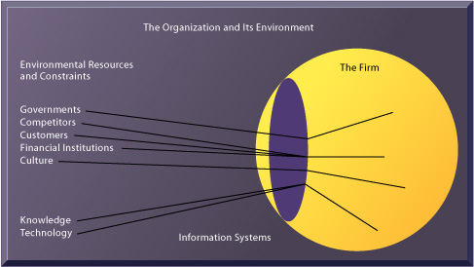
Environments and organizations
FIGURE 3-5 Environments and organizations have a reciprocal relationship
Environments shape what organizations can do, but organizations can influence their environments and decide to change environments altogether.
Information technology plays a critical role in helping organizations perceive environmental change and in helping organizations act on their environment.

Slide 55
Organizations - the differences
Organizations also differ in their
  ultimate goals,
  the types of power used to achieve them,
  the groups and constituencies they serve,
  the nature of leadership within the organization,
  the tasks performed, and
  the technology used.

Slide 56
information systems department
Although the IT function is organized in different ways for different firms, typically the formal organizational unit responsible is the information systems department.
This department consists of programmers, systems analysts, project leaders, and information system managers, and is headed by a chief information officer (CIO).

Slide 57
End users
End users are representatives of outside departments for whom applications are developed.
Today, the information systems department may act as a powerful change agent, suggesting new business strategies and products, and influencing organizational changes. [Figure 3-6]

Slide 58
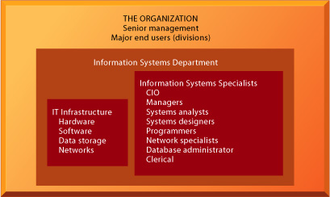
Information technology services
FIGURE 3-6 Information technology services
Many types of specialists and groups are responsible for the design and management of the organization’s information technology infrastructure.

Slide 59
How Information Systems Impact Organizations and Business Firms
From an economic point of view, information technology can be seen as a factor of production that can be freely substituted for capital and labor.
As information systems technology automates the production process, less capital and labor are required to produce a specified output.

Slide 60
Transaction cost theory
Transaction cost theory states that organizations grow in size because they can obtain certain products or services internally at lower cost than by using external firms in the marketplace.
By lowering the cost of market participation (transaction costs) information technology allows firms to obtain goods and services more cheaply from outside sources than through internal means.
Information systems can thus help firms increase revenue while shrinking in size. [Figure 3-7]

Slide 61
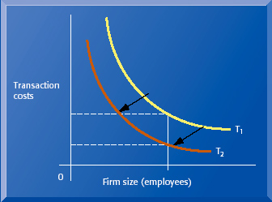
The transaction cost theory of the impact of information technology
FIGURE 3-7 The transaction cost theory of the impact of information technology on the organization
Firms traditionally grew in size to reduce transaction costs.
IT potentially reduces the costs for a given size, shifting the transaction cost curve inward, opening up the possibility of revenue growth without increasing size, or even revenue growth accompanied by shrinking size.

Slide 62
Agency theory
Agency theory views the firm as a nexus of contracts among self-interested individuals, who must be carefully supervised to ensure they pursue the interests of the organization.
Information technology can help reduce agency costs, the costs of coordinating many different people and activities, so that each manager can oversee a larger number of employees. [Figure 3-8]

Slide 63
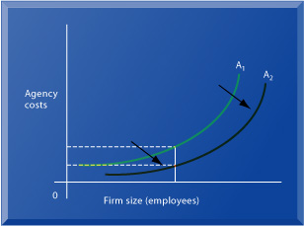
The agency cost theory of the impact of information technology
FIGURE 3-8 The agency cost theory of the impact of information technology on the organization
As firms grow in size and complexity, traditionally they experience rising agency costs.
IT shifts the agency cost curve down and to the right, enabling firms to increase size while lowering agency costs.

Slide 64
IT facilitates flattening of hierarchies
Behavioral researchers have theorized that information technology facilitates flattening of hierarchies by broadening the distribution of information to empower lower-level employees and increase management efficiency. [Figure 3-9]

Slide 65
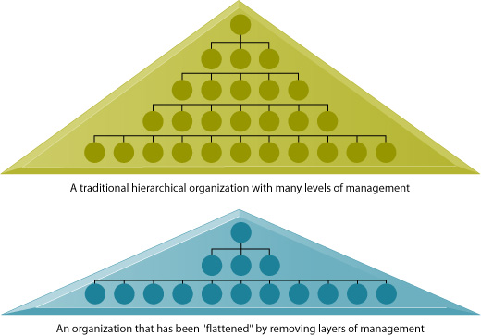
Flattening organizations
FIGURE 3-9 Flattening organizations
Information systems can reduce the number of levels in an organization by providing managers with information to supervise larger numbers of workers and by giving lower-level employees more decision-making authority.

Slide 66
Postindustrial theories
Postindustrial theories also support the idea that IT should flatten hierarchies by allowing professionals to be self-managing, by decentralizing decision making, and by encouraging formation of ad-hoc, temporary “task forces” that address specific tasks.
More firms may operate as virtual organizations, where work no longer is tied to geographic locations.

Slide 67
IT enables flexibility
IT also enables companies to organize in more flexible ways.
Small organizations can use information systems to perform coordinating activities with very few additional workers or managers.
Large organizations can use IT to achieve the responsiveness of smaller firms.
Mass customization, the ability to offer individually tailored products or services, and micromarketing, marketing targeted at finely tuned groups or individuals, can be achieved through the use of information systems without prohibitive costs of additional labor.

Slide 68
Other behavioral view
Another behavioral approach views information systems - as the outcome of political competition between organizational subgroups for influence over the organization's policies, procedures, and resources.
Because information systems potentially change an organization's structure, culture, politics, and work, there is often considerable resistance to them when they are introduced.

Slide 69
Manage people for benefit
In order to reap the benefits of technology, organizational changes in
  technology,
  tasks,
  structure, and
  people
must be managed with as much planning and effort as technology changes. [Figure 3-10]

Slide 70
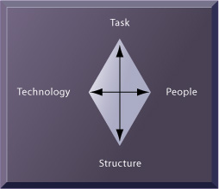
Organizational resistance
FIGURE 3-10 Organizational resistance and the mutually adjusting relationship between technology and the organization
Source: Leavitt (1965).
Implementing information systems has consequences for task arrangements, structures, and people.
According to this model, to implement change, all four components must be changed simultaneously.

Slide 71
Internet and World Wide Web
The Internet and World Wide Web are increasing the accessibility, storage, and distribution of information and knowledge for organizations, dramatically lowering transaction, agency, and distribution costs.
Businesses are rapidly rebuilding some key business processes based on Internet technology.

Slide 72
Challenges for future systems
How managers can more fully utilize information systems to perform their various managerial roles will be an important challenge for future systems and system designers.

Slide 73
Classical vs Behavioral Model
According to the classical model of management, key functions of management are planning, organizing, deciding, and controlling.
But behavioral models show that the actual activities of managers are diverse, fragmented, and performed at a very rapid pace.
Managers prefer current, specific, ad hoc information communicated verbally.
Managers also give high priority to maintaining a diverse and complex web of contacts at virtually all levels of the organization that act as an informal information system.

Slide 74
Interpersonal & Informational Role
In addition to a manager's interpersonal role serving as a liaison between various levels and members of the management team, acting as a figurehead, providing leadership, and attempting to motivate, a manager's activities can be viewed as informational and decisional roles.
The informational role calls on managers to act as nerve centers for the organization, receiving the most concrete, up-to-date information and disseminating it to those who need it.

Slide 75
Decisional Role
The decisional role involves the manager making decisions, acting as entrepreneur, initiating new activities, handling disturbances, allocating staff, and negotiating or mediating conflicts.
According to the behavioral approach, managers spend a significant amount of their time establishing personal agendas and goals, both short- and long-term.

Slide 76
Models for Decision Making
A number of models attempt to describe how business people in firms make decisions.
The rational model of human behavior takes the view that people engage in basically consistent, rational, and value-maximizing decisions.
Critics of this model show that people cannot specify all of the available alternatives and do not have singular goals.

Slide 77
Models for Decision Making (2)
Organizational models of decision-making describe the processes undertaken by groups of people.
According to bureaucratic models of decision making, the most important goals are the preservation of the organization and reduction of uncertainty.
Political models of decision making see decisions as a result of political bargains struck among key leaders and groups.

Slide 78
IS Designers & Systems
Information system designers must consider how organizations and managers make decisions and design systems that are flexible enough to provide many options for handling data and evaluating information.
Systems should reflect bureaucratic and political requirements, with features to accommodate diverse interests as well as reflecting an appreciation for the limits of organizational change.

Slide 79
Information Systems and Business Strategy
A business strategy is an organization’s set of activities and decisions to determine products, industries in which to compete, competitors, suppliers and customers, and long-term goals.
Information systems can be used to support strategy at the business, firm, and industry level.
Value chain analysis is useful at the business level to highlight specific activities where information technology is most likely to have a strategic impact.

Slide 80
Value Chain Model
The value chain model views the organization as a series or "chain" of basic activities that add value to a firm's products.
These activities may be primary activities directly related to the production and distribution of the firm’s products or services, or support activities, such as the organization’s infrastructure, human resources, technology, and procurement that make the delivery of the primary activities possible.
The value chain can be linked to the value chains of its business partners and customers. [Figure 3-11]

Slide 81
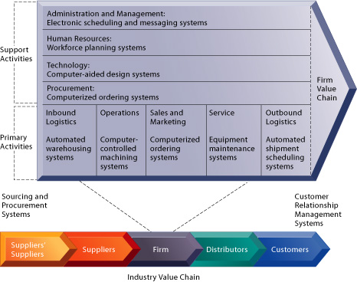
Value Chain & Industry Value Chain
FIGURE 3-11 The firm value chain and the industry value chain
Illustrated are various examples of strategic information systems for the primary and support activities of a firm and of its value partners that would add a margin of value to a firm’s products or services.

Slide 82
IS enable Value Web
Information systems can serve strategically to enable the firm to produce its products at a lower cost or greater value.
Internet technology makes it possible to extend the value chain so that it ties together the firm’s suppliers, business partners, and customers into a value web [Figure 3-12].

Slide 83
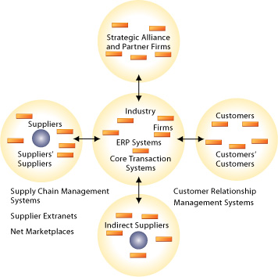
The Value Web
FIGURE 3-12 The value web
The value web is a networked system that can synchronize the value chains of business partners within an industry to respond rapidly to changes in supply and demand.

Slide 84
Competitive strategic with Information Systems
At the business level of strategy, information systems can be used to help firms achieve product differentiation and focused differentiation, and become the low-cost producer.
Information systems can also be used to “lock in” customers and suppliers using efficient customer response systems and supply chain management applications.

Slide 85
Strategic information systems
Strategic information systems should be developed for the internal or external value activities that add the most value.
Information systems can be used for product differentiation to create products or services that cannot be easily duplicated or that serve highly specialized markets, raising the market entry costs for competitors.

Slide 86
Strategic information systems (2)
Information systems can be used for focused differentiation, analyzing and mining existing sales and marketing data to identify market niches, specific targets for a product or service that a firm can serve in a superior manner.
An information system can also give companies a competitive advantage by treating existing information as a resource that can be "mined" to increase profitability and market presentation, as well as identify profitable and non-profitable customers.

Slide 87
Strategic information systems (3)
Strategically oriented information systems can help firms maximize the efficiency of their supply chain and customer response systems, enabling “stockless inventories” and allowing delivery products and services at a lower price than their competitors can provide.
The convenience of using information systems can raise switching costs, the cost to a customer of switching to a competitor’s product or service. [Figure 3-13, Figure 3-14]

Slide 88
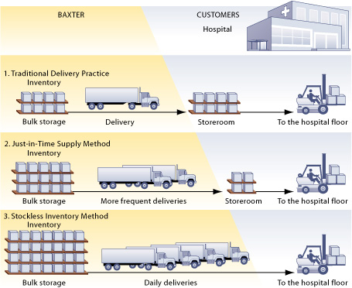
Stockless inventory, traditional and Just-in-time supply methods
FIGURE 3-13 Stockless inventory compared to traditional and just-in-time supply methods
The just-in-time supply method reduces inventory requirements of the customer, whereas stockless inventory enables the customer to eliminate inventories entirely.
Deliveries are made daily, sometimes directly to the departments that need the supplies.

Slide 89
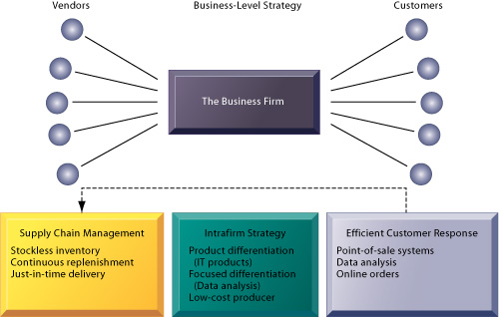
Business-level strategy
FIGURE 3-14 Business-level strategy
Efficient customer response and supply chain management systems are often interrelated, helping firms lock in customers and suppliers while lowering operating costs.
Other types of systems can be used to support product differentiation, focused differentiation, and low-cost producer strategies.

Slide 90
IS @ Firm Level
At the firm level, information systems can be used to achieve new efficiencies or to enhance services by tying together the operations of disparate business units and promoting the sharing of knowledge across business units.
In addition, information systems that encourage the sharing of knowledge across business units can enhance a firm’s core competency, the activity for which the firm is a world leader.

Slide 91
IS @ Industry Level
At the industry level, systems can be used to a provide competitive advantage by facilitating cooperation with other firms in the industry, creating consortiums or communities for sharing information, exchanging transactions, or coordinating activities.
The main concepts for analyzing industry-level strategy are information partnerships, the competitive forces model, business ecosystems, and network economics.

Slide 92
Information partnerships
Information partnerships enable two companies to achieve synergies by sharing information.
The competitive forces model describes the interaction of firms in an industry that affect an organization’s ability to compete:
  the threat of new entrants into its market,
  pressure from substitute products and services,
  the bargaining power of customers and suppliers, and
  the positioning of traditional industry competitors. [Figure 3-15]

Slide 93
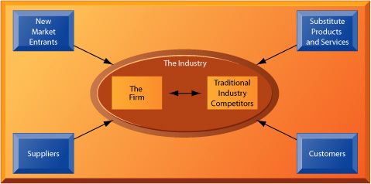
Porter’s competitive forces model
FIGURE 3-15 Porter’s competitive forces model
Various forces affect an organization’s ability to compete and therefore greatly influence a firm’s business strategy.
There are threats from new market entrants and from substitute products and services. Customers and suppliers wield bargaining power.
Traditional competitors constantly adapt their strategies to maintain their market positioning.

Slide 94
IS and Industry-wide Standards
Information systems can be used to develop industry-wide standards, forcing all market participants to subscribe to similar standards, making product substitution less likely and possibly raising entry costs.
The Internet has raised the bargaining power of customers, but it has also created new opportunities for building brands and customer bases.

Slide 95
Business Ecosystems
The Internet and emergence of digital firm has given rise to the concept business ecosystems, loosely coupled but interdependent networks of suppliers, distributors, outsourcing firms, transportation service firms, and technology manufacturers.
The computer chip, automobile, and medical device industries can be seen as industrial sets or ecosystems that involve the cooperation of multiple other industries.
Many firms use information systems to develop into keystone firms by building IT-based platforms that other firms can use. [Figure 3-16].

Slide 96
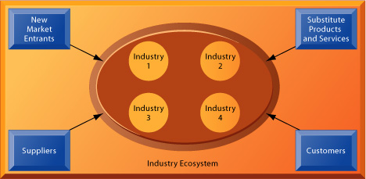
ecosystem strategic model
FIGURE 3-16 An ecosystem strategic model
The digital firm era requires a more dynamic view of the boundaries among industries, firms, customers, and suppliers, with competition occurring among industry sets in a business ecosystem.
In the ecosystem model, multiple industries work together to deliver value to the customer.
IT plays an important role in enabling a dense network of interactions among the participating firms.

Slide 97
Network Economics
Unlike the traditional economic theory of diminishing returns, in network economics, the costs of adding another participant are about zero, whereas the marginal gain is much larger.
For example, it is no more expensive to operate a television station with 1,000 subscribers one than with 10 million.
Information technology can be used to build Web communities of loyal users, or provide services that increase in value and lower in cost with more customers.

Slide 98
Management Opportunities, Challenges, and Solutions
Information technology enables firms to lower transaction and agency costs and develop unique products, services, and processes.
Challenges in using information systems strategically include the difficulties in sustaining competitive advantages as environments change and competitors catch up.
Firms also face resistance to organizational changes required when establishing new information technology and systems.

Slide 99
Using Strategic IS effectively
Solutions for using strategic information systems effectively include performing a strategic systems analysis to analyze the firm’s industry and value chains.
Embracing new strategic information systems will often require changes in
  business goals;
  relationships with customers and suppliers;
  internal operations;
  and information architecture.

Slide 100
Socio-technical changes
These sociotechnical changes, affecting both social and technical elements of the organization, can be considered strategic transitions, a movement between levels of sociotechnical systems requiring new business processes and demanding special management considerations.

